Slide 1
Rule formats
  Decision tables
  Domain Specific Languages
  Creating your own domain language for rules
  JBoss Rules style DSLs
  Hands on lab
  Semantic languages in rules
Notes:
Just an overview of what this module contains. The labs will be fairly “hands on” and will require plenty of time, depending on how must experimenting the students want to do above the exercises.
DSL == Domain Specific Language (in our case, this is as relates to writing production rules – note that DSLs are normally broader then rules, but in this case, it is really just referring to a technique of creating rule languages).

Slide 2
Semantic languages
  Previously, have seen how rules contain snippets of code
  Embedded semantic languages:
  RHS
  LHS
  Eval (java expression resolve to a boolean)
  Predicate (java expression return a boolean, eg function call)
  ReturnVal (java expression return any Object)
rule “blah”
when
p : Person(age == ( ReturnVal ),
a:address -> (predicate))
eval( p.isHappy() )
then
p.doSomething();
sendEmail(p);
end
Notes:
Start with the boring housekeeping (to clarify).
Previously you would have seen semantic code blocks in action. Mostly in terms of eval, and the RHS.
By default, the RHS is one big chunk of semantic java code. (BTW, semantics in this context means “host language”, in this case, java).
Variables can be referenced after they are bound. Variables may be bound to facts (“Columns”) (like “p” above), or fields on a fact (eg “a” above is bound to address – “a” can be referenced in the predicate for instance). These bound variables can then be used in subsequent eval statements, and RHS. Predicate must return boolean.
Note that primitive types in Model objects are autoboxed (not unboxed) – so if you are using primitives, will need to unbox yourself in predicates. ReturnVal must return object of correct boxed type for the field it is being compared with.
Doing this:
o :Object()
eval( something with o) – is basically turning the rule engine into a script engine.

Slide 3
Semantics supported
  Drools 2 supported
  Groovy
  Python
  Java (janino)
  JBoss Rules currently has
  Java via Eclipse JDT
  Java via Janino (system property – useful for some embedded environments: -Ddrools.compiler=JANINO)
  Future
  Aim is to support any semantic language through JCI
  Groovy, Javascript are next targets (both can be compiled efficiently), but also Jruby, Jython if enough interest.
  Want to avoid reliance on semantic language.
Notes:
JCI is Java Compiler Interface (and apache utility).
As semantics are somewhat opaque to the rule engine (it just has to execute and wait for results) they are often a necessary evil, or at best sub optimal. Using semantics only on the LHS kind of reduces it almost to a scripting engine (for some “stateless” scenarios without huge data requirements, this may be acceptable).
Generally, if constraints on facts can be used without an eval, and eval being used last can still perform well, as long as the earlier tests are as restrictive as possible (keep in mind, an eval will be checked each time).
If you can flatten your object model, create lots of small fact objects for the rules, the rules will be neater. The rule language supports lots of constructs (and more are coming) – but at the end of the day , semantics are sometimes necessary.
If you need to create a flattended “rule object model” you can map from the domain objects to the rule objects with rules themselves ! Create some technical “bootstrap” rules (rules that are hidden away in a technical rule file - that have a high salience) – which take the object model facts, then create new instances of rule model facts, and assert them. The main rules can then operate of these “rule object model” facts. Just one option.
Rules are very dependent on object models – no commercial vendors will tell you this. Keep in mind up-coming standards like RuleML, and RIF – these rule interchange formats don't make it easy to include semantics (they have very limited capability for invoking functions). Classic rule engine require you to talk on their terms, but JBoss Rules is kind in letting you work on objects as facts, but sometimes this can be difficult.

Slide 4
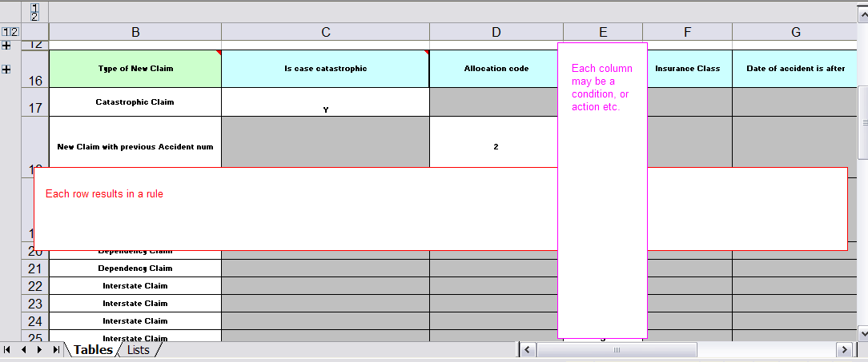
Decision tables
  Decision tables are a precise yet compact way to model complicated logic (wikipedia) – very old fashioned.
  Useful when you have lots of rules that follow similar patterns, or templates.
  Want to have a spreadsheet like view for managing rules
  Seperate the rule constructs from the data that feeds the rules
Notes:
In rule engines (and Jboss rules) the decision table is implemented such that each row results in a rule. Each column is either conditions or actions. When the conditions in each column are satisfied, the action may fire (its still RETE engine underneath, so the normal features like agenda apply).
JBoss rules currently uses Excel, Open Office, or indeed any software that can save-as CSV as a means of capturing decision tables. It has a parser/compiler that extracts rules out of the spreadsheet.

Slide 5
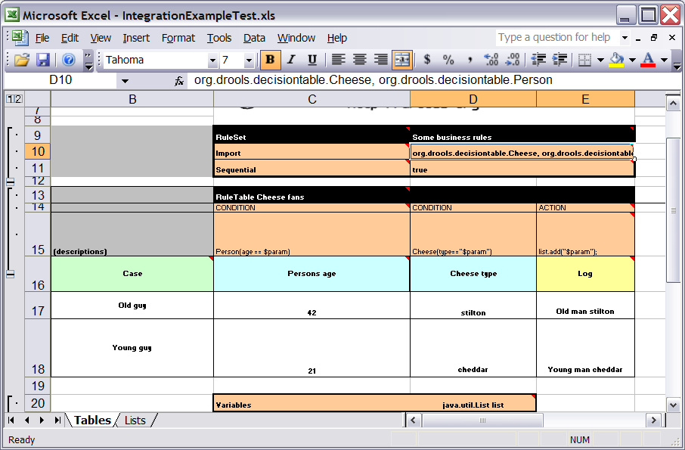
Decision tables - detail
  Header rows contain rule templates, with place holders for data from the rule tables
Notes:
Notice the snippets in row 15. Row 14 indicates that the column represents conditions or actions (you can also set other rule attributes this way – like salience, consult the manual).
Row 15 contains snippets that are combined with the data from the cells below to make a row in a rule (either part of the LHS or RHS).
The rule names (for the generated rules) are extracted from the line numbers.
Column “C” is there the actions starts (due to the RuleSet and RuleTable keywords) – columns to the left are ignored. In Column “C” there can be other keywords that setup rule package level items like Functions, Variables (globals) and Imports (imports are a comma seperated list).

Slide 6
Decision tables, imports etc
Notes:
This shows how other rule package options can be setup in the spreadsheet (you can also keep these in a seperate rule file).
Imports are comma seperated, Variables (globals) similar, but with a name that the variable is referred to in the rules.
You can of course use normal spreadsheet features like lists (for drop downs) and forumlas (to some extent – at compile time all the data must be available).

Slide 7
Decision tables – RuleTable
Can have multiple rule tables – each rule table resets the “templates” for the rows below
Notes:
You will see this more in the lab excercise, don't panic !
You may have different sets of rule templates that you need (groups of rules) – just make sure there is at least one empty line between the RuleTable structures (to reset the templates).
Here is another trick: you can use “Sequential” keyword (just below where RuleSet would be) and have the value as “true” and the priorities (salience) of each rule will be ascending (basically meaning the rules will be run from top to bottom).

Slide 8
Decision Table API
The resulting DRL is vanilla DRL !
It's that simple !
SpreadsheetCompiler compiler = new SpreadsheetCompiler();
String drl = compiler.compile(getSpreadsheetStream(), InputType.XLS);
//can also do InputType.CSV

Slide 9
Next versions of JBoss Rules...
Web based decision tables
  Create and edit via pure web UI.
  Safe for non technical users
  Stored in a versioned repository
Eclipse plug in editor
  Similar to eclipse, but validation as rules are entered etc.
  Excel support to be maintained (has proven popular)

